Slide 1
Office 365 Development

Slide 2
Course Agenda
Introduction to Office 365 Development
Module 1: Overview of Office 365 Development
Module 2: Getting started with Apps for Office
Module 3: Getting started with Apps for SharePoint
Module 4: Getting started with the Office 365 APIs
Module 5: Getting started with Mobile development with Office 365
Module 6: Moving Full Trust Code to the Cloud Using Repeatable Patterns and Best Practices
Module 7: Setting up your Developer environment in Office 365
Module 8: Setting up your on-premises environment for app development

Slide 3
Getting started with the Office 365 APIs

Slide 4

Agenda
Intro to the Office 365 APIs
Getting started
Demos

Slide 5
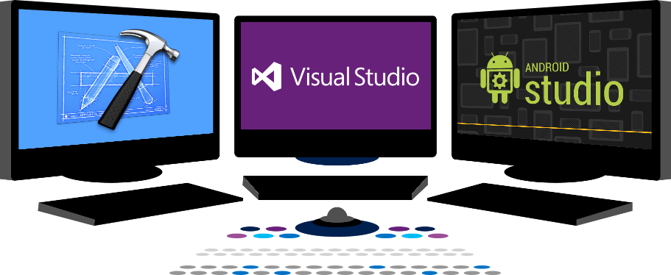














Vision
EXTEND OFFICE EVERYWHERE
CONNECT TO OFFICE 365 SERVICES
BUILD USING AN OPEN PLATFORM
Delve
z
Users and groups
Files
Mail
Calendar
My Apps
Video Portal
Contacts
Office Graph
Presentations
Documents
Spreadsheets
Lync
OneNote
Yammer

Slide 6
Intro to the Office 365 APIs

Slide 7
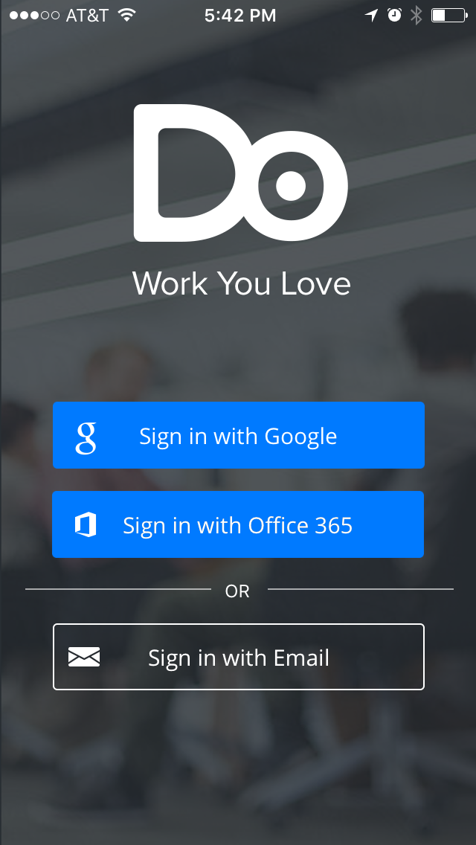
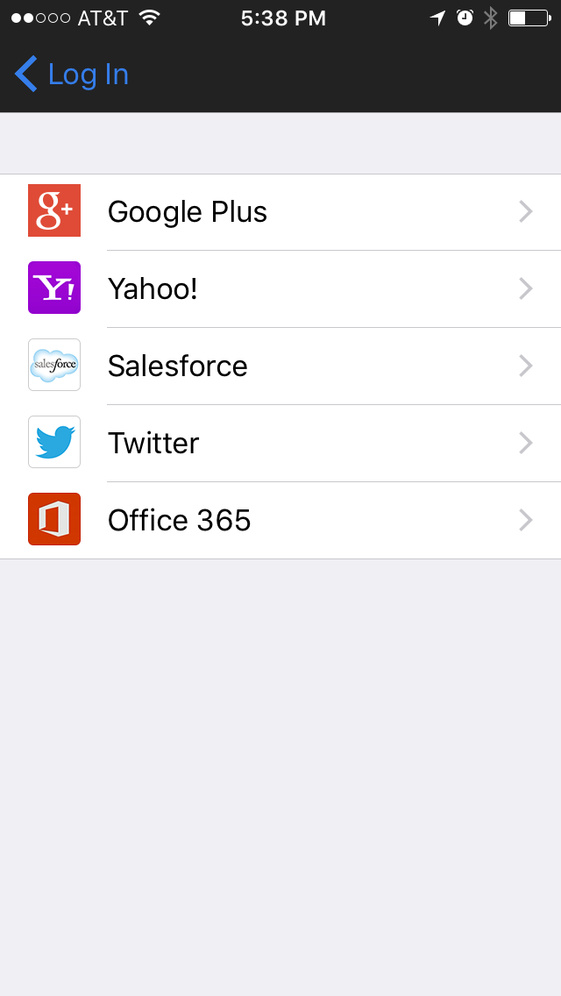
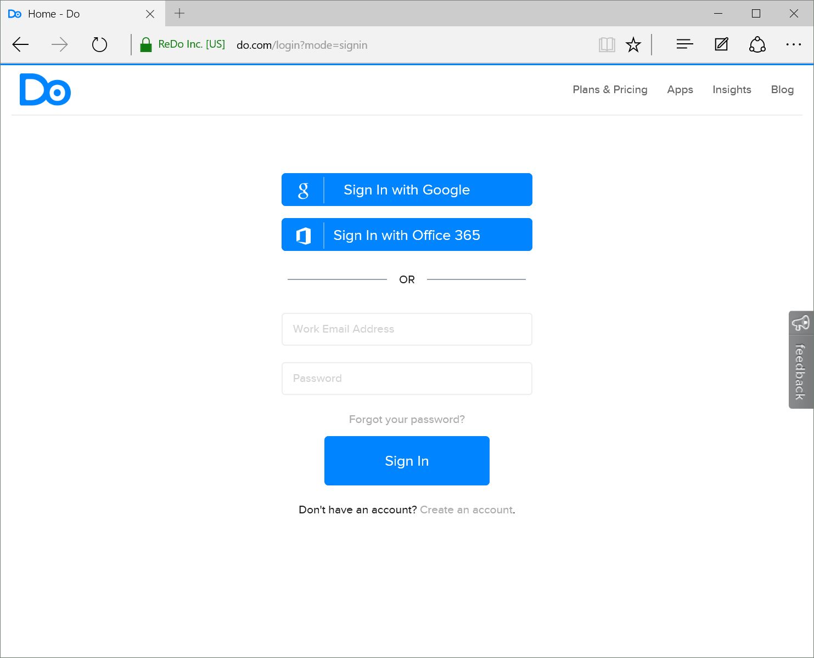
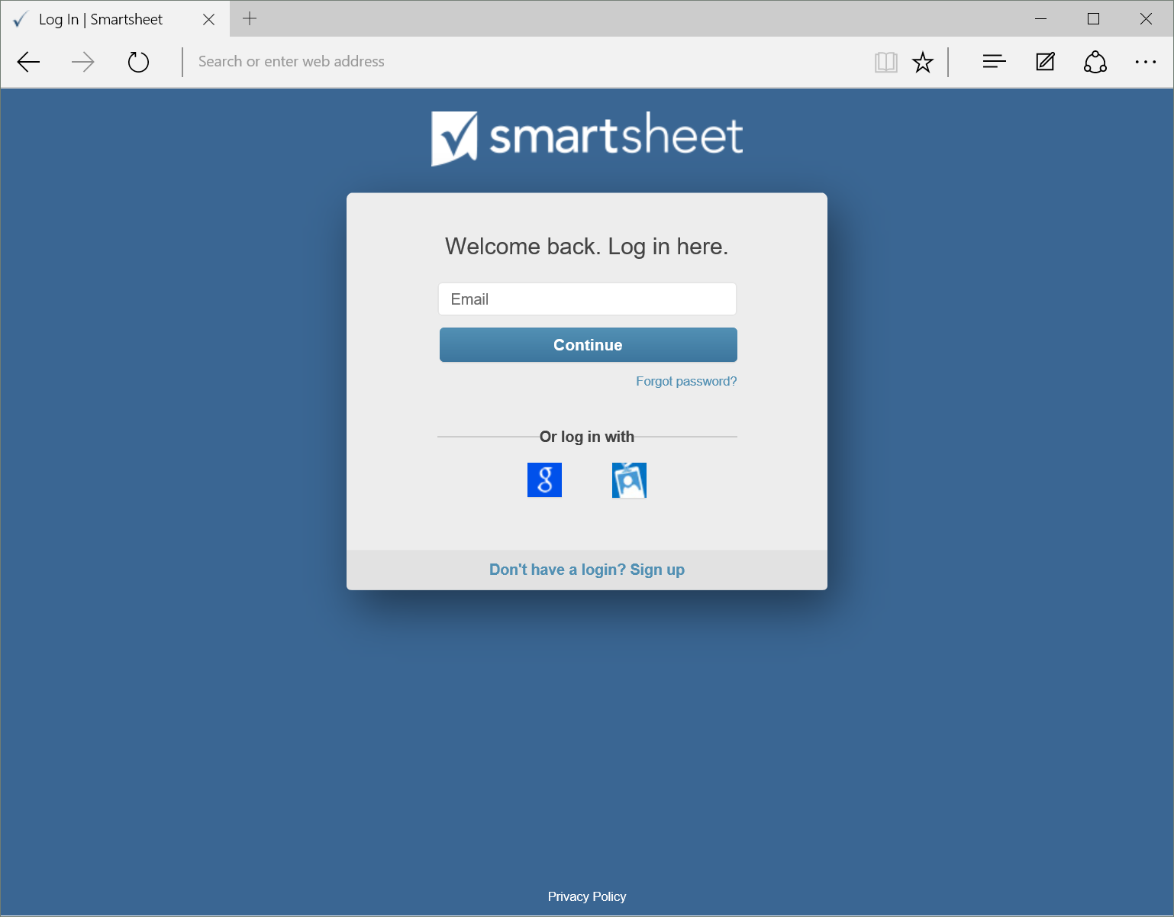
Office 365 connected apps

Slide 8
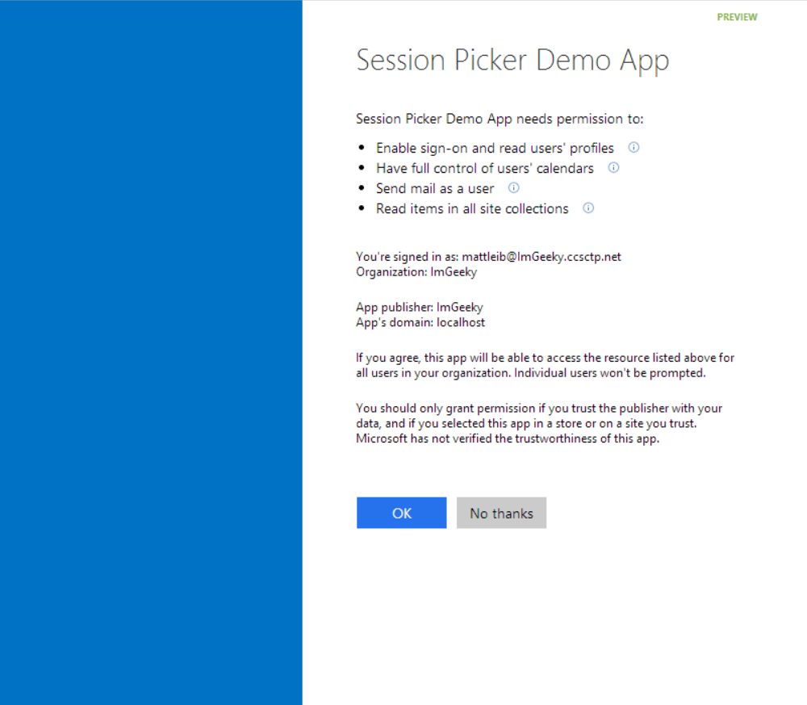
Common consent

Slide 9
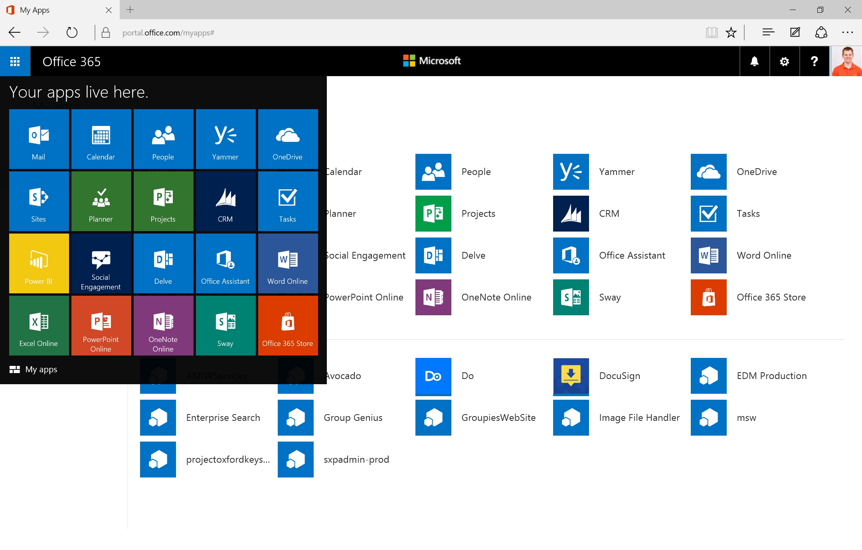
Single authentication flow for Office 365
Azure AD graph, Exchange, SharePoint, OneNote, etc
Device apps and standalone websites
Admin and end-user consent
Pin apps to Office 365 app launcher from My apps

Slide 10
Secure protocol
OAuth 2.0
No capturing user credentials
Fine-grained access scopes
Supports MFA and federated user sign-in
Long-term access through refresh tokens

Slide 11
Office 365 discovery services
Automatically determine URL of O365 services
Supports device app and website flows
Secured using Azure AD authentication
Serves information stored about services in AAD

Slide 12
Office 365 Unified API End-Point
Single resource that proxies multiple Microsoft services
Allows for easy traversal of objects and relationships
Simplifies token acquisition and management
Eliminates the need to traditional discovery (using “me” and “myorganization”)

Slide 13
Robust Office 365 APIs
Designed for openness and flexibility
Enabling a consistent development platform
Powering a world of devices
https://graph.microsoft.com
https://api.office.com/discovery/me
Documents
Mail
Calendar
People
Search
Office Graph
Groups
Notebooks
Videos
Social
iOS
dev.office.com
Notes:
Do.com
Docusign

Slide 14
demo
Graph Explorer
https://graphexplorer2.azurewebsites.net
Notes:
https://graph.microsoft.com/beta/me
https://graph.microsoft.com/beta/me/manager
https://graph.microsoft.com/beta/me/messages
https://graph.microsoft.com/beta/me/events
https://graph.microsoft.com/beta/me/files
https://graph.microsoft.com/beta/me/files/{id}/createdbyuser/manager
https://graph.microsoft.com/beta/me/files/{id}/createdbyuser/manager/?$whatif
https://graph.microsoft.com/beta/myorganization/users
https://graph.microsoft.com/beta/myorganization/groups
https://graph.microsoft.com/beta/me/joinedgroups
https://graph.microsoft.com/beta/me/joinedgroups/{id}/files
https://graph.microsoft.com/beta/me/joinedgroups/{id}/conversations

Slide 15
Getting Started

Slide 16
http://dev.office.com/getting-started

Slide 17
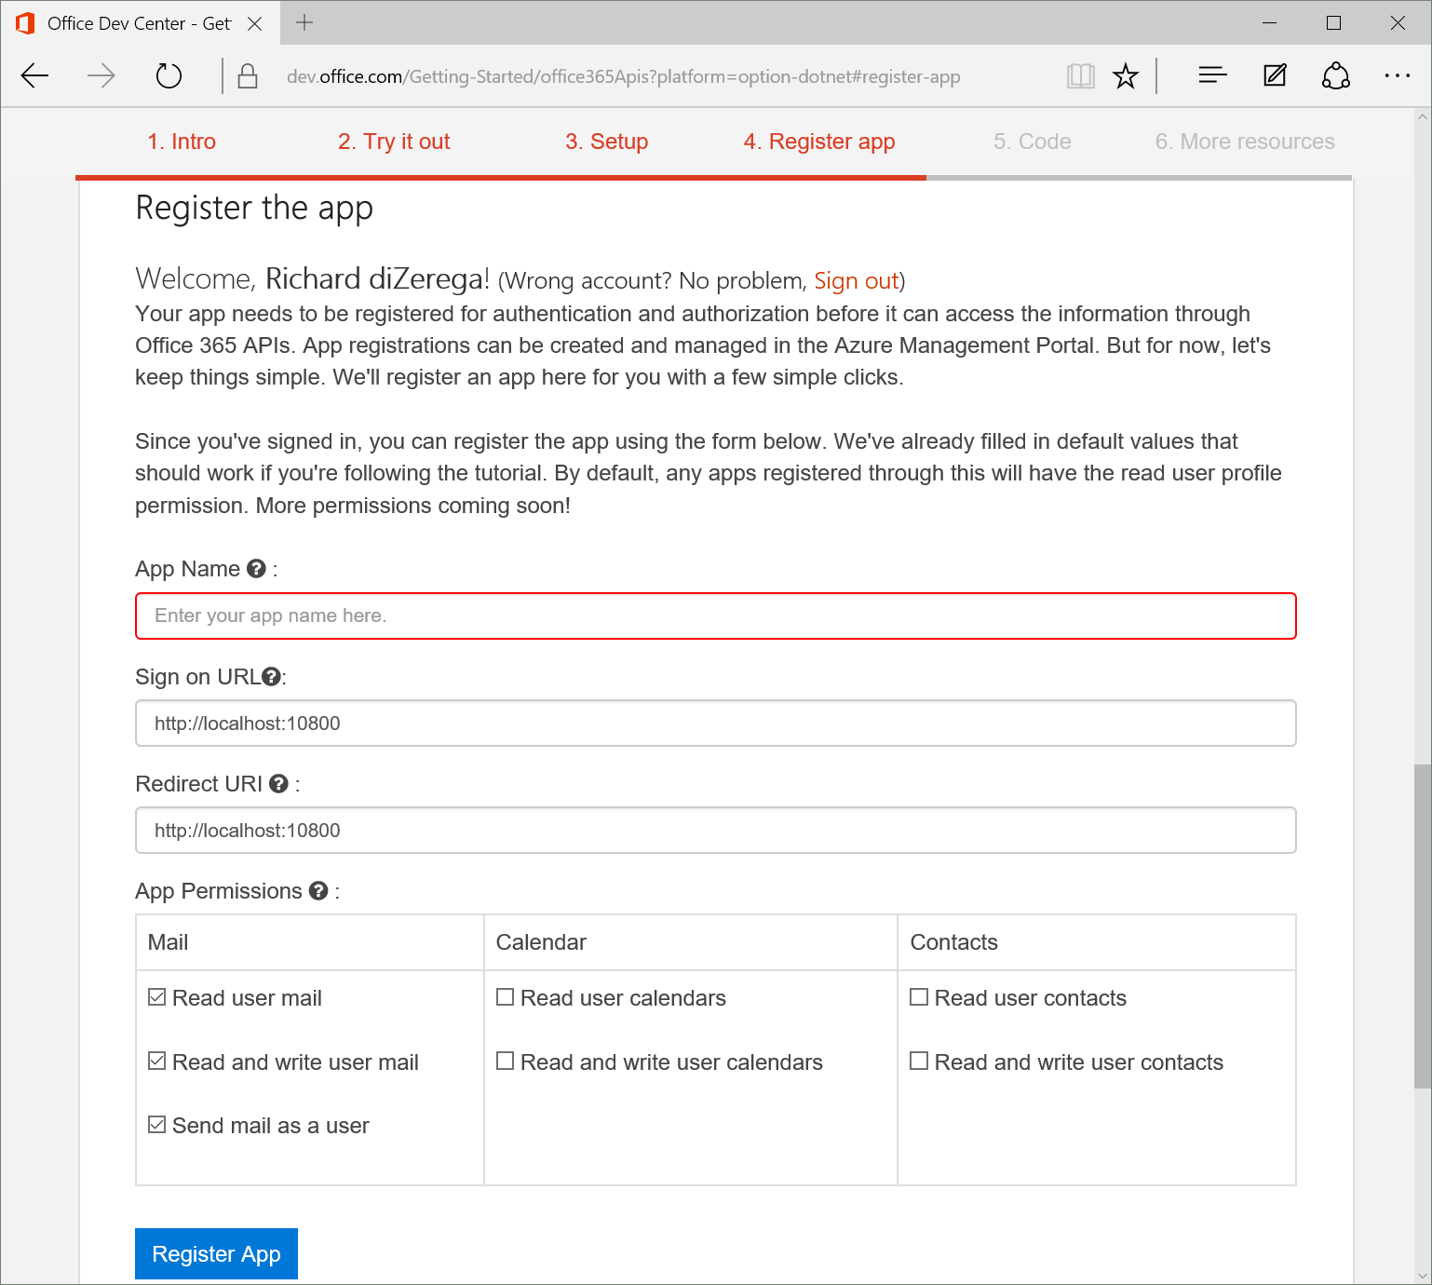
Register App from dev.office.com

Slide 18
Azure Management Portal Access

Slide 19
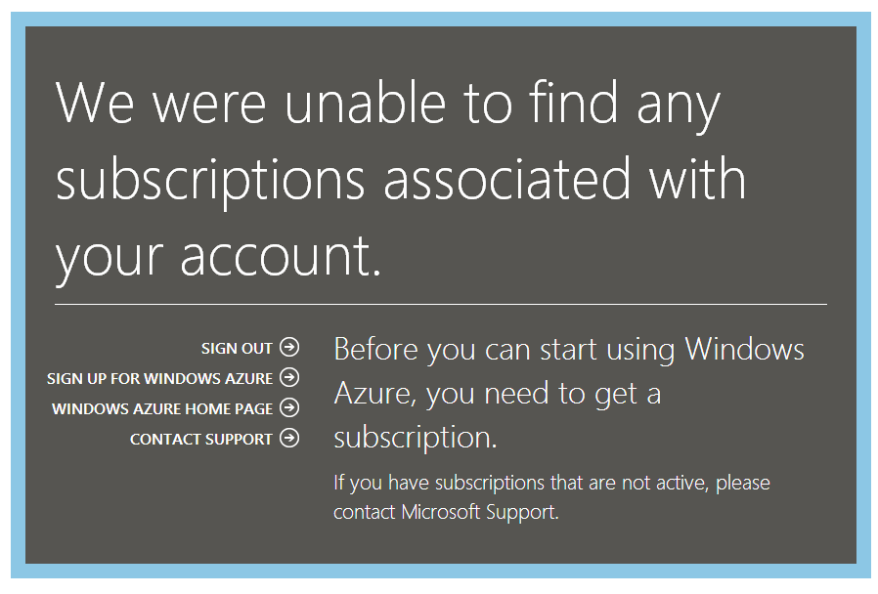
Azure Management Portal (new tenant)

Slide 20
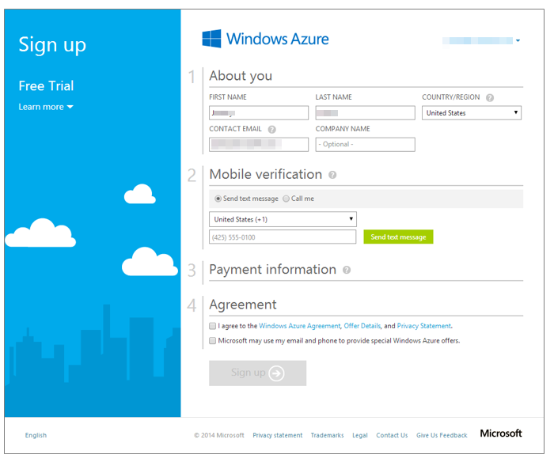
Azure trial sign-up – part 1

Slide 21
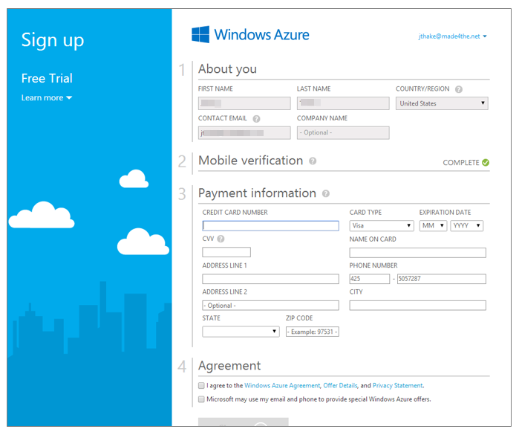
Azure trial sign-up – part 2

Slide 22
demo
Registering Application
Notes:
Show app registration from http://dev.office.com/getting-started/office365apis and through azure management portal

Slide 23
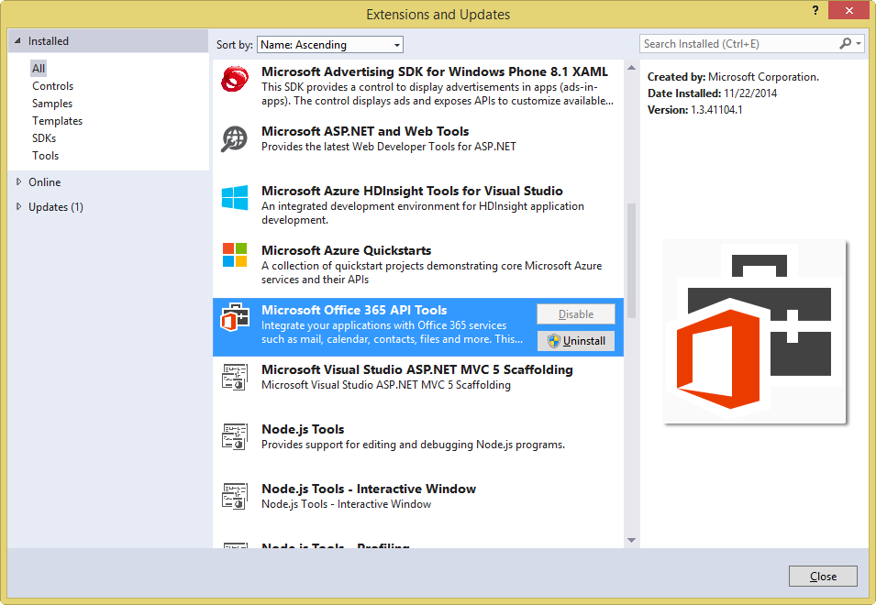
Get the tools

Slide 24
Visual Studio project support
.NET Windows Store Apps
Windows Forms Application
WPF Application
ASP.NET MVC Web Application
ASP.NET Web Forms Application
Xamarin Android and iOS Applications
Multi-device Hybrid Apps (Cordova)

Slide 25
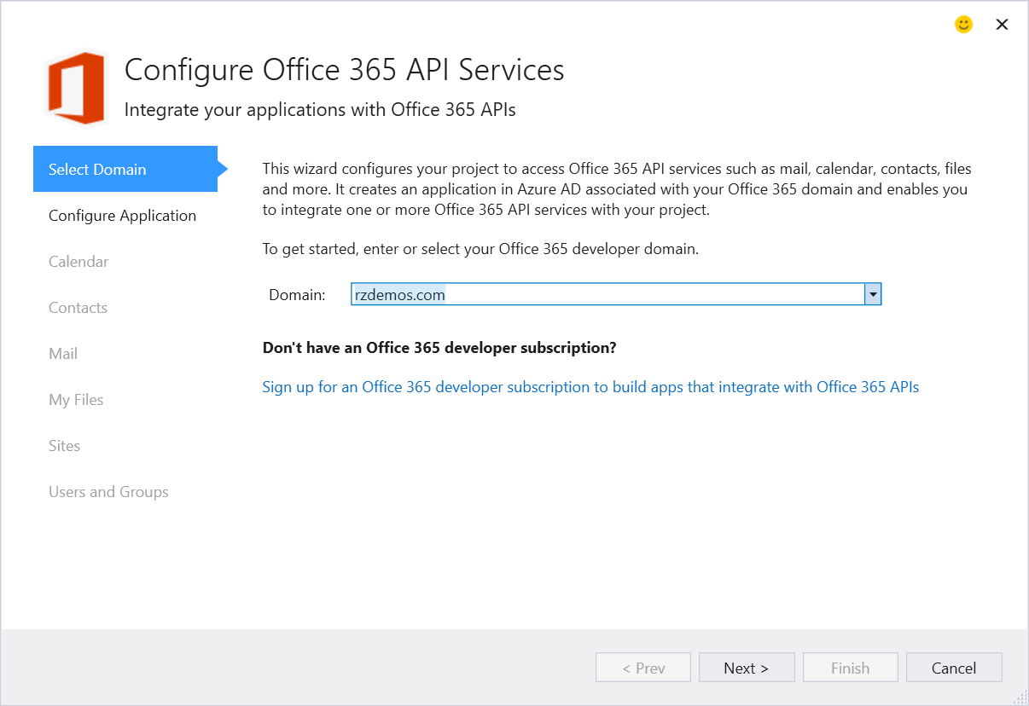
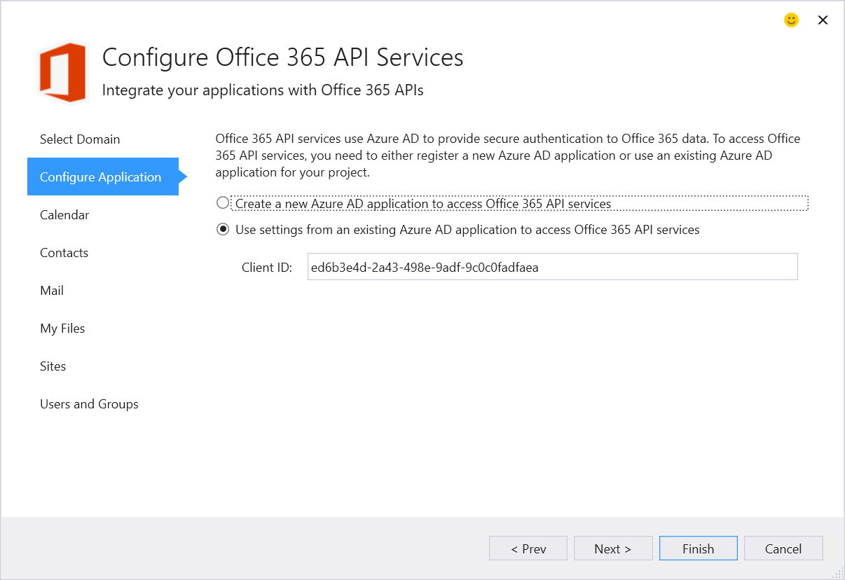
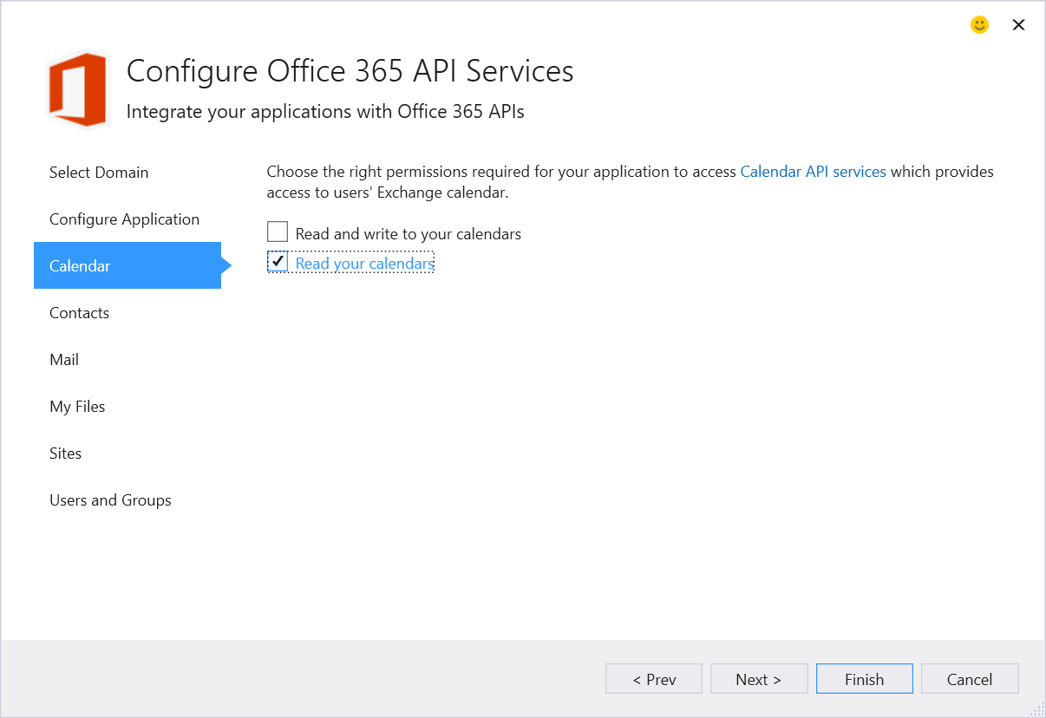
Connected Service Wizard

Slide 26
demo
Getting started Office 365 API tools for VS ASP.NET MVC

Slide 27
demo
AngularJS HTML/JS project demo
Notes:
https://github.com/OfficeDev/O365-Angular-ArtCurator

Slide 28
Summary
Intro to the Office 365 APIs
Getting started
Demos

Slide 29



dev.office.com
Sign up
http://dev.office.com/getting-started
Explore
http://apisandbox.msdn.microsoft.com
Get trained http://dev.office.com/training

Slide 30


Feedback
Office 365 Network Share you best practices and join conversations https://www.yammer.com/itpronetwork
Stackoverflow Ask deep technical questions to a world-wide set of developers
http://stackoverflow.com/questions/tagged/ms-office
UserVoice Provide suggestions of what you want in future versions
http://officespdev.uservoice.com/

